Slide 1
Presentation on
“Convolutional Neural Network for Sentence Classification”
Presented By
Sohanoor Rahman
ID: 23273009
CSE713

Slide 2
Intorduction
Achieved result in NLP and image Processing
Proposed single CNN model
Trained on 100 billion words
Excellent result in multiple benchmark

Slide 3
Dataset
Movie Reviews datasets
Stanford Sentiment Treebank(SST-1)
Subjectivity dataset(Subj)
TREC question datasets
Customer reviews datasets
MPQA datasets

Slide 4
Methodology
One Layer CNN model
Pre-trained word vector from word2vec
Three variants of model
Model architecture allows the use of both pre-trained and task-specific vector.
Model achieve excellent result on multiple benchmark

Slide 5
Hyperparameters
Hyperparameters used in experiments are RLU, filter size of 3,4 and 5 with 100 feature maps each, dropout rate of 0.5, l2 constraint of 3 and mini batch of 50
There were chosen through grid search on SST-2 dev set
Training process involves in stochastic gradient decent over shuffled mini batches with Adadelta update rule.

Slide 6
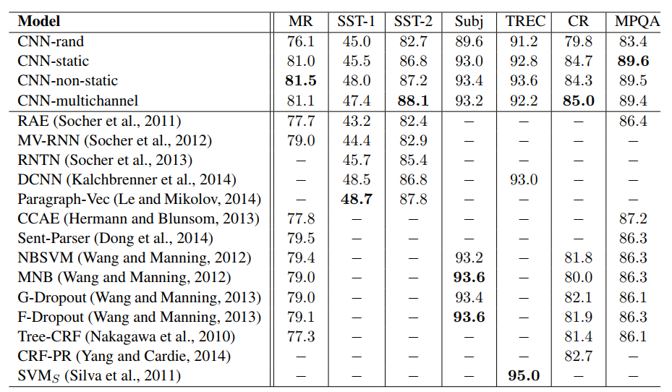
Results

Slide 7
Limitation
Does not provide detailed information on specific results.
Hyperparameter and word vectors were not discussed properly.
Does not explore the reason behind superior performance of word2vec.
Limitation of the CNN architecture.
Does not provide comprehensive analysis.

Slide 8
Future Scope
Improved Sentence Classification
Fine-tuning and Task-specific Vectors
Generalization to different domains
Comparison with other models

Slide 9
Thank You!

